Slide 1
The European Centre for Modern Languages of the Council of Europe
Towards a Common European Framework for Language Teachers (2016-2019)
Vers un Cadre européen commun pour les enseignants de langues (2016-2019)

Slide 2
What is the purpose of the project?
Teacher competences relating to language teaching and languages in education are crucial factors in the quality and effectiveness of education.
Several previous projects have generated frameworks and descriptions of many of these competences.

Slide 3
What is the purpose of the project?
However, no overview of these frameworks and their potential uses, and no overarching framework covering all aspects of languages in teaching yet exist.
This project seeks to bridge these gaps.

Slide 4
Team members
http://www.ecml.at/ECML-Programme/Programme2016-2019/TowardsaCommonEuropeanFrameworkofReferenceforLanguageTeachers/CEFR-team/tabid/1876/language/en-GB/Default.aspx

Slide 5
Envisaged project ‘outputs’
A user guide to existing competence frameworks for language education and beyond
Practical examples of how the existing tools are used
Further development, piloting and empirical validation of existing tools
An inventory of key language teaching competences
An examination of the need for, and feasibility of, a Common European Framework of Reference for Language Teachers.

Slide 6
A. THE PROPOSED USER GUIDE TO FRAMEWORKS OF TEACHER COMPETENCE
First stage of the project:
Review existing frameworks for language teachers and teachers in general
Produce a catalogue or inventory of these
Prepare a guide to frameworks for language teacher education and development

Slide 7
Focus of analysis
Frameworks and tools related to language teaching competences:
  General
  Specialised (e.g. pre-primary educators, CLIL etc.)
Frameworks for teachers of any subject/all subjects (e.g. from Australia, Finland, France, Germany, UK).
Other relevant documents, e.g. from the Council of Europe, European Commission, OECD, UNESCO

Slide 8
What has been done so far?
The project group has researched and listed:
  28 frameworks and tools for language teachers from various countries
  12 other frameworks for teachers of all subjects
  18 other documents relevant to the topic of teacher education and teaching competences
Many have now been analysed and evaluated
Work has begun on the layout and the possible content of the Guide website.

Slide 9
B. CASE STUDIES OF INSTRUMENTS IN USE
Concrete examples of how some of the instruments are used in practice, e.g. in teacher education, teacher development, in action research projects, etc.

Slide 10
C. PILOTING AND FURTHER DEVELOPMENT
OF SELECTED INSTRUMENTS
Profession-related language competence profiles
CARAP/FREPA and REFDIC: Competences / resources for language teachers
the European Profiling Grid or/and the Eaquals Framework

Slide 11
D. OVERVIEW OF KEY COMPETENCES
Which are the relevant key competences and attributes for all teachers, and for teachers working in specific contexts?
  Foreign language teaching
  CLIL and subject teaching
  Language education for migrants
  Sign language
What professional learning and experience can contribute to the development of these competences and attributes?

Slide 12
E. FEASIBILITY STUDY
Do we need a Common European Framework for Language Teachers? If so:
What should be included?
How should it be developed?
What form should it take?
…

Slide 13
Joining the consultation network
Would you be interested in helping with this work by providing feedback, participating in piloting etc.?
If so, please contact the coordinator or one of the team members.

Slide 14
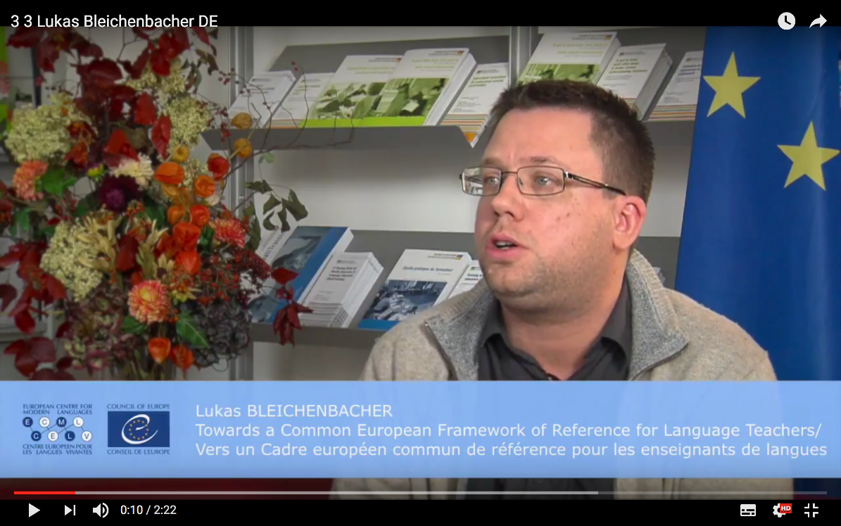
Watch the project video on Youtube
In English
En français
Auf Deutsch

